Slide 1
Lecture 5. Classroom English
1. Lesson opening.
2. The main part of the lesson.
3. The end of the lesson.
4. Corrective Feedbacks

Slide 2
1. Lesson opening
Opening: lessons begin in a particular way the procedures the teacher uses to focus the students’ attention on the learning aim of the lesson
The main part: the lesson proceeds through a series of teaching and learning activities used to attain the goals of a lesson.
The end: the lesson reaches a conclusion

Slide 3
The opening of a lesson
occupies the first 5 minutes
consists of “the procedures the teacher uses to focus the students’ attention on the learning aims of the lesson” (Richards & Lockhart, 1994)
is the moment when the teacher can decide whether the learners would be engaged in the lesson or not (Scrivener, 2012).

Slide 4
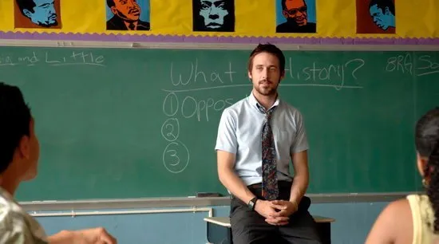
In the opening, the teachers explains:
the aims of the lesson,
how the lesson is connected to the previous ones
what activities they are going to do.

Slide 5
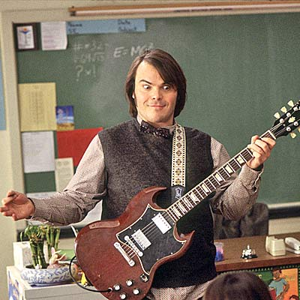
At the lesson opening teachers should pay attention to:
creating the atmosphere,
encouraging motivation, confidence or participation,
preparing the students to be ready for the lesson,
eliciting relevant knowledge and experience,
providing an organizing framework for the lesson.

Slide 6
At the beginning the teacher uses phrases for the following purposes:
to introduce himself (if needed)
to greet the students
to announce the beginning of the lesson
to ask the students to prepare for the lesson
to check who is absent
to greet those who are late (if needed)

Slide 7
Introductions
My name is Maiia Ivanivna. I’ll be teaching you English this year.
I’m your new English teacher.
I’ve got five lessons with you each week.
Greetings
Hello, everyone.
Good morning, everybody.
How are you getting on?
Are you feeling better today, Vlad?
What a lovely day!
What a rainy day!
It’s very cold today, isn’t it?

Slide 8
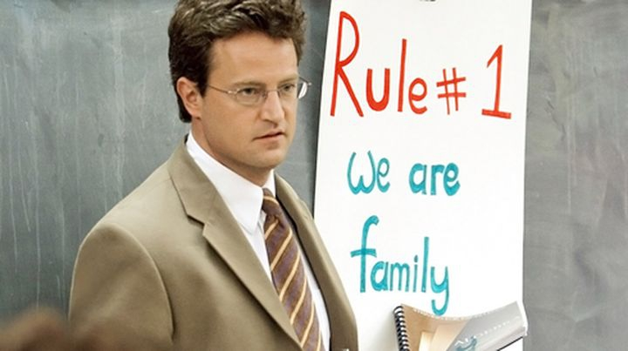
Time to begin
Let’s begin our lesson now.
I think we can start now.
Now we can get down to work.
It’s time to begin, please stop talking.
I’m waiting for you to be quiet.
Settle down now so we can start.
Is everybody ready to start?
I hope you are all ready for the lesson.

Slide 9
Put your things away
Pack your things away.
Close your books.
Put your books away.
Register
Who is absent today?
Why were you absent last Friday, Denis?
What’s the matter with Anna today?
Late
We started ten minutes ago. What have you been doing?
Did you oversleep?
Don’t let it happen again.
Where have you been?

Slide 10
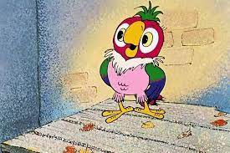
Variants of beginning a chat

Slide 12
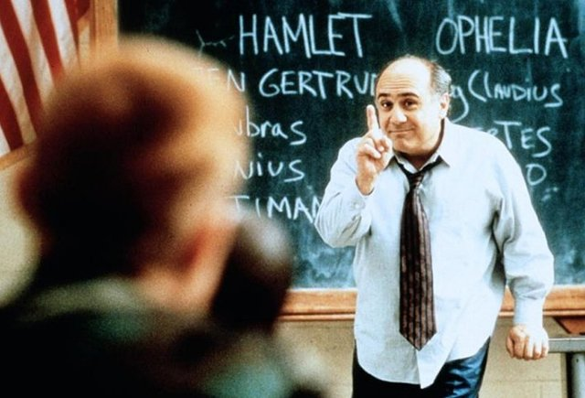
2. The main part of the lesson
Presentation
Practice
Production

Slide 13
Presentation
The “presentation” of an ESL lesson generally introduces:
the topic,
grammar points,
vocabulary,
key expressions to be taught.
Suggestions for presentation activities:
A quick video or another type of visual works pulls students in. Asking lots of questions to get students engaged with the new material works great, too.
Recommended time:
5 minutes (out of a 45-60 minute lesson)
Role of the teacher:
Leader

Slide 14
Practice
Students begin to practice with the target language. This is a guided section of the class, one in which the role of the teacher is to give examples and monitor student responses.
Suggestion for a practice activity:
Pairing English expressions in question and answer form.
Recommended time:
10 minutes (out of a 45-60 minute lesson)

Slide 15
Production
The students produce the language practiced. The teacher should simply monitor students at this point, interfering only to help with major mistakes or to clarify instructions.
Suggestions for production activities: Active and engaging games are key at this point, even when instructing one-on-one.
Recommended time:
Each production activity should take around 10-15 minutes, including time to set up and instruct (out of a 45-60 minute lesson)

Slide 16
Instructions to be used at the beginning of a session
Open your books at page…
You need pencils/rulers.
We’ll learn how to …
You have five minutes to do this.
Turn to page …
Look at activity five.
Listen to this dialogue.
Repeat after me.
Who’s next?

Slide 17
Do you follow me?
What did you say?
Say it again, please.
Other common instructions
Come in.
Go out.
Stand by your desks.
Stand up.
Sit down.
Come to the front of the class.
Put your hands up.
Put your hands down.
Comprehension language

Slide 18
Giving instructions
Open your books at page 75.
I want you all to join in.
The whole class, please.
All together now.
Come out and write it on the board.
Listen to the tape, please.
Get into groups of four.
Finish off this exercise at home.
Could you try the next one?
I would like you to write this down.
Would you mind switching the lights on?
Who would like to read?
Which topic will your group report on?
Do you want to answer question 4?
Can you all see the board?

Slide 19
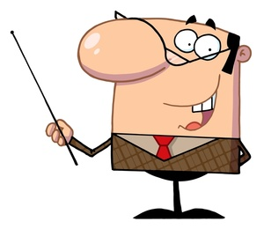
Sequencing
First/ First of all, today, …
After that/ Then
Right. Now we will go on to the next exercise.
Have you finished?
Whose turn is it to read?
Which question are you on?
Next/ Next one, please.
Who hasn’t answered yet?
Let me explain what I want you to do next.
The idea of this exercise is for you to …
You have ten minutes to do this.
Your time is up.
Finish this by twenty to eleven.
Have you found the place?
Are you all ready?

Slide 20
Supervision
Stop talking.
Look this way.
Listen to what … is saying.
Leave that alone now.
Be careful.
Questions
Do you have any questions?
Now I’m going to ask you some questions.
Who knows the answer?
Raise your hand.
Try to answer by yourself.
Try again.
Use a full sentence please.
Say it in a loud voice.
Again, please.

Slide 21
Responding to questions
Yes, that’s right,
Fine.
Almost. Try again.
What about this word?
Reference
As I said earlier, …
While we’re on the subject, …
In the background you can see …
The church was started in the last century.
This is a picture of a typically English castle.
Let me sum up.

Slide 22
Encouragement
That’s interesting!
Don’t worry, I’m sure you’ll do better next time.
I’m really impressed. I knew you could do it!
Have a go! Have another try!
Practise makes perfect.
Good! Excellent! Well done! That’s great!
That’ much better! You’re really improving.
Your marks will get better if you practise more.
Stop making excuses.
Your marks are getting better all the time.

Slide 23
3. The end of the lesson
The final part of the lesson :
serves to reinforce what has been learned in a lesson
integrates and the reviews the content of the lesson
prepares the students for further learning

Slide 24
At the end of the lesson the teacher:
summarizes the things you have learned
gives marks to the students
gives home task
says goodbye.

Slide 25
Expressions to finish the lesson
There's the bell/ That's the bell. It's time to stop
We've run out of time
The next class is waiting (outside/ to come in)
You'll be late for your next class (if you don't stop now)
We'll have to finish this tomorrow/ in the next lesson
Look at the time/ What time is it now?
30 seconds to finish that activity. It's nearly time to go
That's all (we have time) for today

Slide 26
Hometask
Copy tonight's homework from the board
Circle these exercises in your workbooks
Do exercise 10 on page 23 for (your) homework
Do the next exercise tonight, and we'll check it tomorrow
Check your answers at the back of the book and ask me tomorrow if you have any questions
Learn this list of words (for homework/ by tomorrow)
There is no homework today
Take a worksheet as you leave.
What do you have to do before the next lesson?

Slide 27
4. Corrective Feedbacks
Feedback types
(after Craig Chaudron):
Explicit Correction
Recast
Clarification Request
Metalinguistic Feedback
Elicitation
Repetition

Slide 28
The teacher gives the correct variant
Explicit Correction
The teacher tells the student he/she is wrong, and then provides the correction.
Student: “He eated.”
Teacher: “No, that’s wrong. He ate.”
Recast
The teacher repeats the student’s answer correctly.
Student: “He eated”
Teacher: “He ate”.

Slide 29
Clarification Request
The teacher indicates that the student’s utterance needs to be repeated or reformulated
Student: “He walk to the shore”
Teacher: “What?”
Metalinguistic Feedback
The teacher repeats student’s utterance, or asks questions related to the mistake without providing the correct form
Student: “He walk to the shore”
Teacher: “No. You need to put an “s” on the verb if the subject is he, she, or it.”
The teacher hints that some mistake has been made

Slide 30
Elicitation
The teacher uses various strategies to elicit the correct form from the student.
The student: “Yesterday, he walks to school”
Teacher (1): “No, Yesterday he …”
Teacher (2): “How do we talk about the past in English?”
Teacher (3): “Please say that again correctly”.
The teacher leads the student to give a correct variant

Slide 31
Repetition
The teacher repeats a learner’s incorrect utterance, usually with marked intonation or volume to highlight the error.
Student: “He eated.” Teacher: “He eated?”
The teacher repeats the mistake of the student

Slide 32
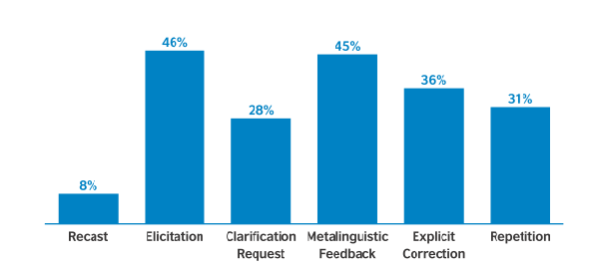
Effectiveness of corrective feedbacks

Slide 33
Giving feedback to students
Magnificent!
Right!
Very good.
Well done.
That’s correct.
That’s right.
That’s quite right.
It depends.
That’s much better.
You’ve improved a lot.
Have a guess.
You’re halfway there.
You’ve almost got it.
You were almost right.
There’s no need to rush.
We have plenty of time
Unfortunately not.
I’m afraid that’s not quite right.
Not quite right. Try again.
Good try, but not quite right.
You can’t use that word here.
Have another try.
Not exactly.

Slide 34
Written Feedback Tips

Slide 35
Written Feedback Tips

Slide 36
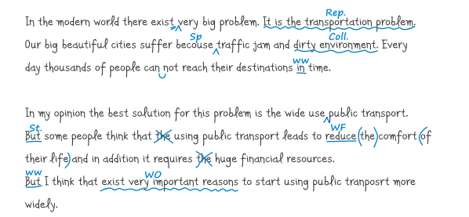

Slide 37
