Slide 1
Lecture 2. Teaching Receptive Skills
1. Skills Required for Effective Reading and Listening.
2. Methodological Principles for Teaching Receptive Skills.
3. Teaching Listening.
4. Teaching Reading.

Slide 2
1. Skills Required for Effective Reading and Listening
Predictive skills
To foresee what we are going to read about

Slide 3
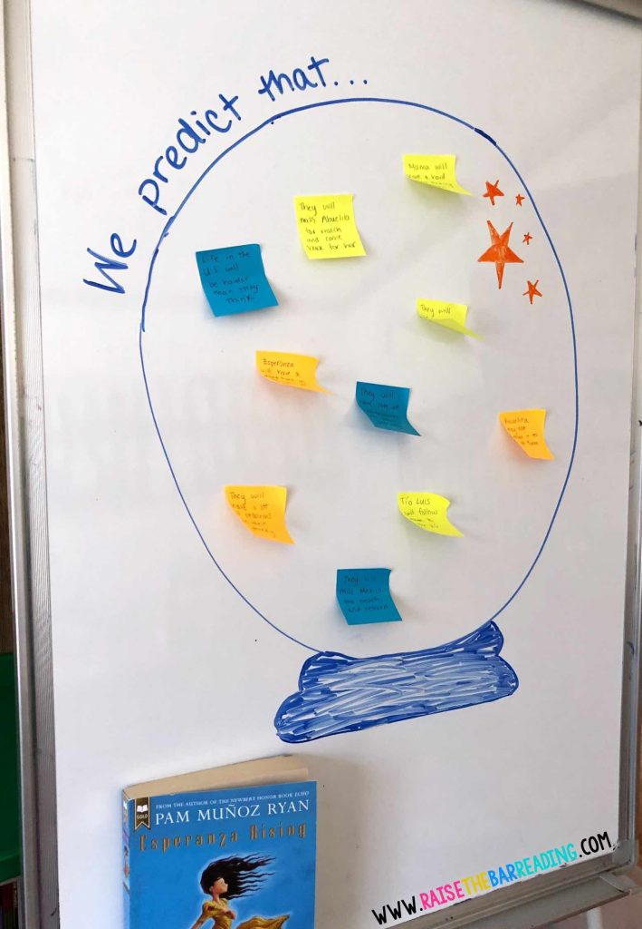
How can students practice making predictions in reading?
PROVIDE THINKING STEMS
I think_____ will happen, because___”
“Based on the title, I think the text will be about___”
“Based on the headings/subheadings, I think the text will be about ___”
“Based on what I know about _____, my guess is___”

Slide 4
Skills of getting the general idea
Skimming
to have an idea of the main points of the text without being too concerned with the details

Slide 5
Skills of extracting detailed information
“How many?”
“Why?”
“How often?”, etc.

Slide 6
Skills of extracting specific information
Scanning
To read to extract specific facts

Slide 7
2. Methodological Principles for Teaching Receptive Skills
Receptive and productive skills
Students can generally deal with a higher level of language in receptive skills than in productive skills.
Being able to understand a piece of text does not necessarily mean that students have to be able to write or speak like that.
All over the world there are students who can read English but unable to speak it very well.

Slide 8
Authentic and non-authentic texts
Authentic texts are created by the native speakers for native speakers: they are “real” texts (English-language newspapers, radio programs).
Non-authentic texts are written especially for language-learning students. Their aim is to isolate some language units so that students can concentrate on them.
Texts – whether authentic or not – must be realistic models of written or spoken English.
Teachers should choose the right kind of material (and use appropriate teaching techniques) which will help students achieve success.

Slide 9
Purpose, desire and expectations
People usually read or listen to something because they have a desire to do so and some purpose to achieve.
They generally have some expectations about what they are going to read or hear.
The tasks for reading and listening must reflect facts about real life, be realistic and motivating.
Students are expected to perform some task (give opinions, follow the instructions, write something, fill in the chart, summarize, have a conversation.

Slide 10
Model for the Teaching Receptive Skills
Pre-Reading / Listening Stage
While-Reading / Listening Stage
Post-Reading / Listening Stage

Slide 11
Pre-Reading / Listening Stage
The teacher introduces students to the topic of the reading or listening to create expectations and arouse the students’ interest in the subject.
The teacher explains comprehension tasks to the students to make sure they know what they are going to do (to answer questions, fill in a chart, complete a message or try and retell what they heard/saw).

Slide 12
While-Reading / Listening Stage
During this period the students should:
Identify what’s important in the text.
Perceive the text structure.
Keep themselves concentrated.
Show their understanding or non-understanding of the text.

Slide 13
Post-Reading / Listening Stage
The teacher organizes some follow-up activities related to the text:
answer the questions
summarize the text
discussion
information exchange
problem solving

Slide 14
3. Teaching Listening Comprehension
The main reason for getting students to listen to spoken English is to let them hear different varieties and accents – rather than just the voice of their teacher.
It’s good when they listen not only to British English, but also other variants of English.
The main method of exposing students to spoken English (after the teacher) is through the use of taped material.
The second major reason for teaching listening is the fact that it helps students to acquire language subconsciously even if teachers do not draw attention to its special features.
Through listening students get information about grammar, vocabulary and pronunciation.

Slide 15
Types of Classroom Listening Materials 1. Reactive
Sometimes you simply want a learner to listen to the surface structure of an utterance for the purpose of repeating it back to you.
The only role that reactive listening can play in an interactive classroom is in brief choral or individual drills that focus on pronunciation.

Slide 16
2. Intensive
The purpose is to focus on some specific speech components: phonemes, words, intonation, discourse markers, a grammatical structure, etc.

Slide 17
3. Responsive
Short stretches of teacher’s speech, which are expected to be followed by immediate students’ responses:
Asking questions (“How are you today?” “What did you do yesterday?”).
Giving commands (“Take out a sheet of paper and a pencil.”).
Seeking clarification (“What word have you said?”).
Checking comprehension (“So, how many people were in the park?”).

Slide 18
4. Selective
While listening to long monologues, the task of the student is to scan the material selectively for certain information.
Examples of the material include:
Speeches.
Media broadcasts.
Stories and anecdotes.
Students may be asked to listen for:
People’s names.
Dates.
Certain facts of events.
Location, situation, context, etc.
Main ideas and/or conclusion.

Slide 19
5. Extensive
It aims to develop full comprehension of spoken language. Extensive performance could range from listening to lengthy lectures to listening to a conversation.

Slide 20
6. Interactive
It includes all five of the above types, as learners actively participate in discussions, debates, conversations, role-plays, and other pair and group work.
Their listening performance must be integrated with speaking.

Slide 21
Factors That Make Listening Difficult:
Clustering: in spoken language we break down speech into clusters of words, not into sentences.
Redundancy: rephrasing, repetitions, insertions of “I mean” and “you know”.
Reduced forms: phonological, morphological, syntactic, and pragmatic.
Performance variables: hesitation, reformulation, topic change, false starts, pauses, ungrammatical forms.
Colloquial language: idioms, slang, reduced forms, shared cultural
Rate of speed. Every language learner initially thinks that native speakers speak too fast. Actually the number and length of pauses used by a speaker is more crucial to comprehension than speed.
Stress, rhythm, and intonation: significant for interpreting questions, statements, emphasis, messages like sarcasm, insult, etc.

Slide 22
Dealing with listening problems
Main listening problems:
panic
difficulty

Slide 23
Some tips for the teacher to help the students deal with listening problems:
Repeat segments of tape for detailed work (e.g. script dictation).
Let your students check their answers to the comprehension task together in pairs or groups before organizing a feedback stage.
If the text is long, play half of it and then get the students to predict what will happen next.
Give the students the first third of the tapescript to be read at home.
Choose a small number of key words that students do not know and teach them to the students before they listen.

Slide 24
4. Teaching Reading
Reasons for Teaching Reading in Class
1. Students want to be able to read texts in English for many purposes:
for their careers
for study purposes
for pleasure
2. Reading texts provide opportunities to study language through:
vocabulary
grammar
punctuation
the way sentences are constructed
3. Good reading texts can:
introduce interesting topics
stimulate discussion
excite imaginative responses
be a springboard for well-rounded, fascinating lessons

Slide 25
Kinds of Texts for English Language Students
Authentic Texts | Artificially Created Texts
look natural | look artificial
may be too difficult in terms of vocabulary and grammar patterns | correspond to the students’ level
A balance has to be struck between real English on the one hand and the students’ capabilities and interests on the other.

Slide 26
The topics of the texts depend on who the students are:
If they are all business people, the teacher may concentrate on business texts.
If they are science students, reading scientific texts may be a priority.
If they are a mixed group with differing interests and careers, the choice of various topics is appropriate.
The teacher might want the students to read:
magazine articles
letters
stories
menus
advertisements
reports
play extracts
recipes
instructions
poems
reference material

Slide 27
Types of Classroom Reading Activities
Classroom reading activities
silent
intensive
extensive
aloud
linguistic
content
skimming
scanning
reading for detail

Slide 28
READING ALOUD
Advantages
Disadvantages
an evaluative check
a pronunciation check
some extra student participation if you want to highlight a certain short segment of a reading passage
it is not a very authentic language activity
while one student is reading, others can easily lose attention (or be silently rehearsing the next paragraph)

Slide 29
SILENT READING
INTENSIVE READING usually focuses on the linguistic or semantic details (grammatical forms, discourse markers, implications, etc.)
EXTENSIVE READING is carried out to achieve a general understanding of a text. A learner can do it at his/her own ability level, with a comfortable speed, choosing longer texts to the taste.

Slide 30
SKIMMING (getting the general information) is used to:
see what’s in the news in a paper or on a website
browse through a book to see if you want to read it
look through the television guide to see what’s on one evening
flick through a catalogue to see what’s on offer
look through the options given on a Google search to see what sites it suggests

Slide 31
Strategies to master skimming:
Set a purpose for reading.
What do you want to get out of it? Why are you reading it? Keep this purpose in mind as you read.
Preview. Look through the text and focus on:
headings,
illustrations,
captions,
highlighted items,
end of chapter summaries, etc.
Make a prediction.
Right after previewing, make a prediction about what you think the chapter or section is going to be about.

Slide 32
Strategies to master skimming:
Activate prior knowledge.
Make the list of what you already know about the topic and what you want to know about it.
Summarize the main ideas.
After a section or page, stop and write a 1-3 sentence summary in your own words.
Generate questions.
Ask and write down questions that you have as you read the text or questions that you would ask a class if you were a teacher.

Slide 33
SCANNING (reading to search some particular information) is used to:
look up a word in a dictionary or index
find an address or a phone number in a directory
check what time your programme is on television
look up details or prices in a catalogue
pick out the website you want from options on a Google search

Slide 34
Steps to follow while scanning:
Get to know some basic things about the topic
before starting to scan a text for a particular information.
Skim the text first
to get some ideas about it.
Notice how the information is arranged.
It can be arranged either alphabetically or numerically. If it is not, you have to guess a section and scan it through to get your information.

