Slide 1
Lecture 3. Teaching Productive Skills
1. Communication and Teaching Productive Skills.
2. Teaching Speaking.
3. Teaching Writing.

Slide 2
1. Communication and Teaching Productive Skills.
Participants of communication:
a speaker (and/or writer)
a listener (and/or reader)

Slide 3
The process of written and spoken communication includes three stages
communicative intent (a person wants to say something)
communicative purpose (he wants something to happen as the result of what he has said)
selection of the language means to achieve this communicative purpose

Slide 4
Effective communication is achieved if:
both the speaker and the listener wish it to be effective;
the listener wants to listen while the speaker wants to say something;
the listener is interested in the communicative purpose of what is being said (what ideas the speaker is conveying);
the listener understands what the speaker is saying (he or she has to be prepared to process a great variety of grammar and vocabulary to understand exactly what is being said);
the speaker masters the language well enough to realize his communicative intent.

Slide 5
Reason for communication:
In real life the genuine reason for communication is the information gap – one person wants to get to know something, another one may have this information.
In classroom it’s the task of the teacher to create such information gaps to initiate communication between students.

Slide 6
Classroom Activities Characteristics:

Slide 7
Stages in Teaching Productive Skills:
1. Introductory Stage (should be kept short).
The teacher:
introduces new vocabulary and grammatical structures
asks students to repeat and perform in drills
insists on accuracy, correcting where students make mistakes.
2. Practice. Practice activities often have some features of both-communicative and non-communicative activities. During practice activities, the teacher may intervene slightly to point out inaccuracy.
3. Communicative activities. Communicative activities are those which exhibit the above mentioned six characteristics. Such activities are vital in a language classroom since here the students can do their best to use the English language as individuals.

Slide 8
2. Teaching Speaking
Genres of spoken conversation:
description (telling the details to an active listener)
narration (telling the development of events to an active listener)
reasoning (telling one’s train of thought to an active listener)
identification (talking about one’s likes and dislikes)
language-in-action (people doing things and talking)
comment (opinions and points of view)
service encounters (buying and selling goods and services)
debate and argument (seeking a solution and pursuing one’s point)
learning (use of language in learning)
decision-making (peo­ple working towards a decision).

Slide 9
When teaching speaking, two types of activities are used:
activities which presuppose language use, strictly guided by the teacher
activities which assume free language use

Slide 10
Guided Language Use 1. Drills
For the students, drills can:
For the teacher, drills can:
Provide for a focus on accuracy.
Provide learners with practice in hearing and saying words or phrases.
Build confidence among learners who are not risk-takers.
Help students notice the correct form or pronunciation of a word or phrase.
Help memorisation and automisation of language patterns.
Help in terms of classroom management to get all the students involved.
Help the students recognize if new language is causing problems in terms of form or pronunciation.

Slide 11
You can vary the drill
In terms of who repeats:
In terms of sounding:
whole class
half the class
boys only
girls only
individuals
whisper drills (for quietening down a rowdy class)
shouting drills (for livening them up)
drills pronounced as if you are happy, sad, surprised, frightened

Slide 12
Repetition drills
listening to a model, provided by the teacher, or a tape, and repeating what is heard

Slide 13
Substitution drills
Are used to practice different structures or vocabulary items (i.e. one or more words change during the drill).
Example:
Prompt: 'I go to work. He?'~
Response: 'He goes to work.'
This is used for practicing common adjacency pairs:
What's the matter? - I've got a (headache).
Can I have a (pen) please? - Yes, here you are.
The words in brackets can be substituted during the drill.

Slide 14
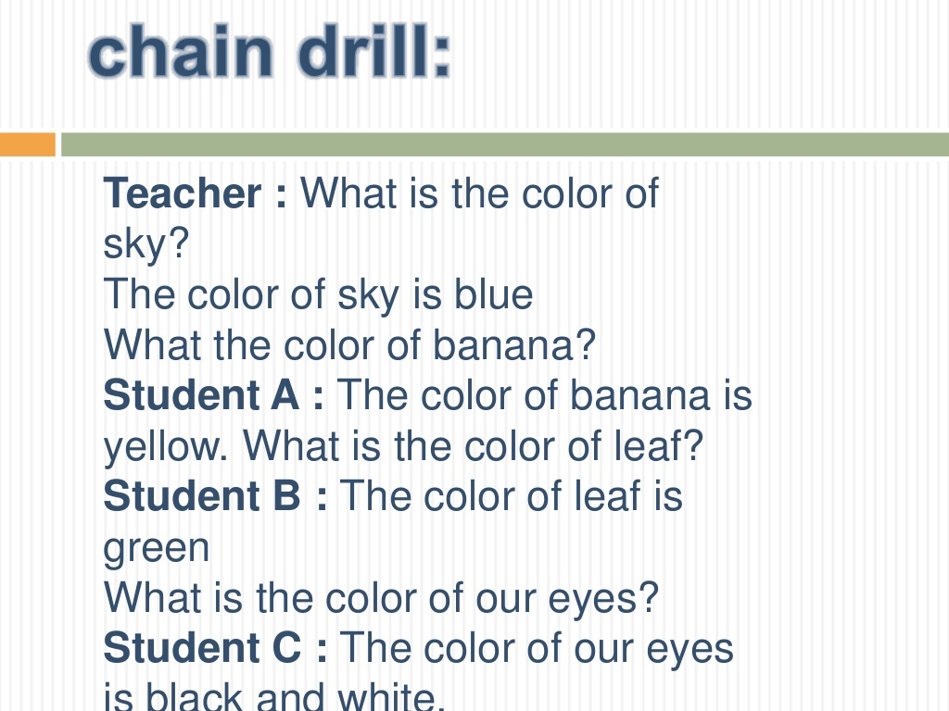
Chain drills
Ways of practicing a particular structure over and over again in the context of a game.

Slide 15
2. Information Gap Activities
An information gap refers to when students don’t have all the information they need to complete a task or activity.
Information gap activities require students to speak and to practice teamwork, working with their classmates to acquire the missing information.
Once they’ve learned the information from their classmates, they can fill the “gap” and complete the task or activity.

Slide 16
Information Gap Activities Exercise 1. Charts

Slide 17
Information Gap Activities Exercise 2. Job Interview
Practice: Talking about experiences, professions and characteristics.
Procedure:
Divide students into groups of two. One student is the interviewer, the other is the interviewee.
Provide the interviewee with a profession and short backstory.
Example:
Student A: Where did you study?
Student B: I studied at ABC University.
Student A: What did you study?
Student B: I studied medicine.
Student A: What are your strengths?
Student B: I’m hardworking and passionate.

Slide 18
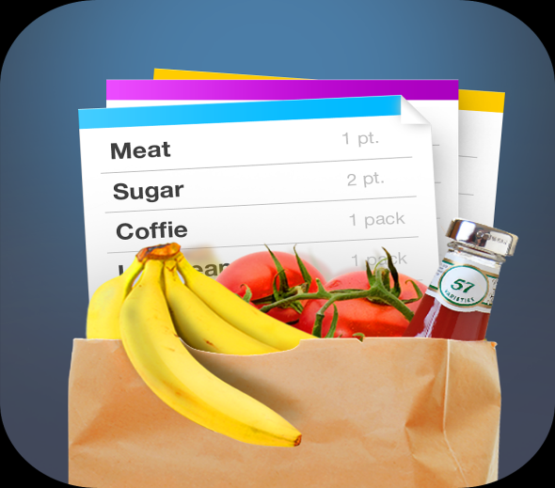
Information Gap Activities Exercise 3. Making a Grocery List
Practice: Food vocabulary and amounts.
Procedure:
One student is the Chef, the other is the Shopper.
Provide the Chef with a recipe using simple food words and measurements.
The Shopper must create a shopping list based on the Chef’s dish.
Example:
Shopper: What are you making?
Chef: Caesar Salad.
Shopper: What do I need to buy?
Chef: Lettuce, cucumbers, chicken, and cheese.
Shopper: What kind of cheese?
Chef: Parmesan.

Slide 19
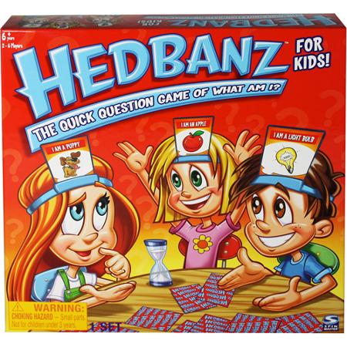
3. Games Game 1. Twenty Questions
Practice: Speaking.
Procedure:
One student thinks of an item or object (or has a picture of it).
The other students must ask questions in order to figure out what item the student is thinking of.
The questions should be “yes” or “no” questions.
If the students can’t guess the item within 20 questions, the student who’s thinking of the item wins the game.
Example:
Student B: Is it alive?
Student A: No.
Student C: Is it bigger than my desk?
Student A: Yes.

Slide 20
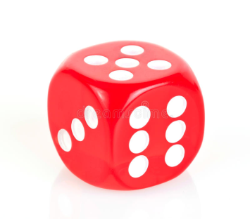
3. Games Game 2. This is How We Roll
All you need:
one standard die
6 questions – either ice breakers or ones that elicit opinions, experience or other personal thoughts.
What you should do:
Give the students a list of numbered questions.
Have students take turns rolling the die.
Whatever number they roll, that is the question they must answer.

Slide 21
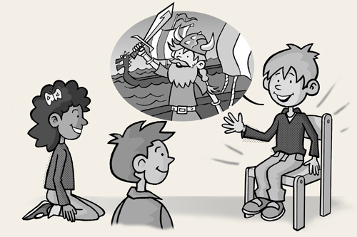
4. Personalization Exercise “The Hot Seat”
Practice: Question-Answer Patterns
Procedure:
A student is put in the ‘hot seat’ and subjected to a barrage of questions.
Other students ask him as many questions as they know.
Example:
S1: What did you do yesterday evening?
S2: I went to the supermarket.
S1: Why?
S2: Because I needed some things.
S3: What did you buy?
S2: Eggs, milk . . . that kind of thing.

Slide 22
Free Language Use 1. Reaching a Consensus Activities
Activity 1. Going to London
Students are told that they are going on holiday to London and have to decide what 10 objects to take with them.
Stage 1. All the students write down 10 items they would choose to have in their luggage if they were going to stay in London for 2 weeks.
Stage 2. Students are put into pairs to negotiate a new list of 10 items. Stage 3. When the pairs have completed their lists, two pairs are joined together to negotiate a new list that all four students can agree to.
Stage 4. Groups can now be joined together and the lists re- negotiated.

Slide 23
1. Reaching a Consensus Activities Activity 2. Moral dilemmas
Students are given a situation and alternative suggestions
for acting in a certain situation.
Stage 1. Students are told that they are watching over an important final school test. They see a student cheating with notes he has illegally brought into the classroom. They have four possible courses of action.
Ignore the incident.
Warn the student that if he cheats again he will be reported to the authorities.
Ask the student to leave the exam, tear up his paper and mark him as absent.
Stage 2. Students are put in small groups to reach a consensus on this issue.
Stage 3. Pairs of groups are combined and have to reach a consensus on which alternative to adopt.

Slide 24
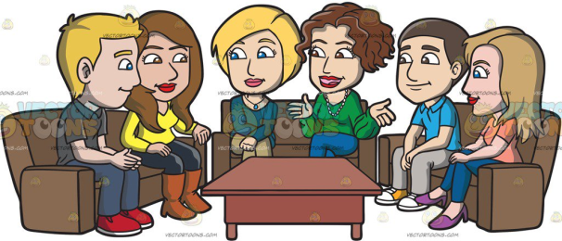
2. Discussion
Some hints about organizing discussions:
Put students in groups. This will allow them to give opinions in a less threatening environment than in front of the whole class. It will also give the teacher a chance to see if the topic is interesting for the students.
Give students a chance to prepare. Students need a chance to prepare their opinions. If they are to discuss the role of the family or the relative merits of radio and television, they need time to organize their thoughts and come up with arguments to support their case.
Give students a task. One way of promoting discussion is to give students a task as a part of the discussion process.

Slide 25
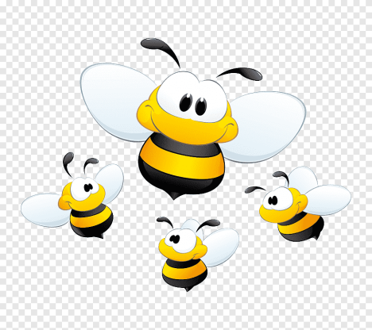
Examples of discussion activity:
Activity 1. The buzz group
Students are put into loose groups of three or four (the number is unimportant) and asked to think of the topic.
Frequently the teacher may ask them to think of “as many.. . as possible” (e.g. as many seaside activities as possible).
Buzz groups can form the introduction to a larger discussion session.

Slide 26
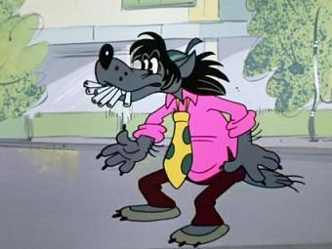
Activity 2. Controversial topics
The students are given the statements
about smoking and told to circle the number
which best reflects their agreement or disagreement
with the statement (0= totally disagree, 5 = totally agree).
Smoking should be banned in all public places. 0 1 2 3 4 5
Smokers should be forced to give up the habit. 0 1 2 3 4 5
People who smoke in no-smoking areas should be put in prison. 0 1 2 3 4 5
There should be separate areas for smokers in restaurants and cafes. 0 1 2 3 4 5
When they have done this, they proceed as if for a consensus activity (they compare their answers in pairs and then groups and they have to agree a score).

Slide 27
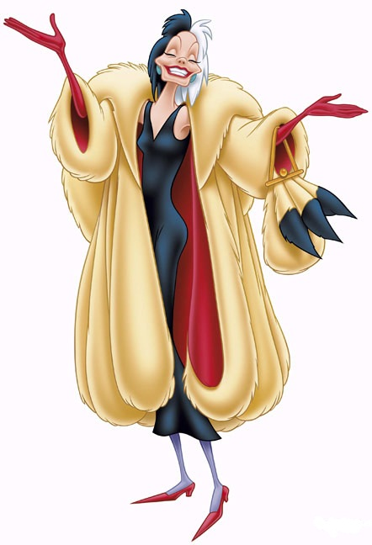
Activity 3. The debate
In this type of activity two sides argue
a case which is then put to the vote.
Suitable for more advanced classes.
1. Students are given a controversial proposition, e.g. People who buy fur coats should pay a 100% tax.
2. They are then put into two groups which have to prepare arguments either in favor of the proposition or against the proposition.
3. When the arguments are ready, the teams elect a proposer and a seconder who make formal speeches to argue their case. All the other students can take part with short interventions.
4. At the end of the discussion, the teacher can organize a free vote to see whether the proposition wins or not.

Slide 28
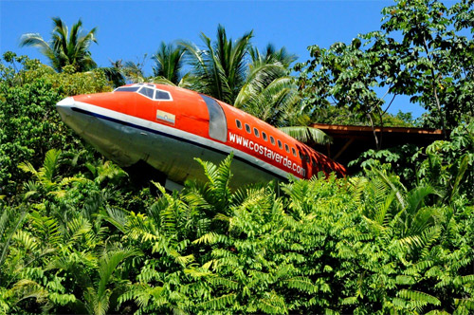
3. Problem Solving
Activity “Desert dilemma”
Students are given the following situation:
It’s 10 in the morning in July. Eleven passengers including you have just crashed in a small airplane in the desert in Northern Mexico. The pilot and co-pilot are dead. One of the passengers is injured. The area is flat. The temperature is about 43 °centigrade (110° Fahrenheit). The survivors think that they are 50 kilometers south of a small town.
The following items came out of the crash in good order:
Compass / Jack knife / Loaded pistol / Vodka / Parachute
The task:
Individually write down a list of the 7 most important items on this list to ensure survival and/or rescue.
Students are put in groups and should agree with the other members of the group what these items are.
Each group works out how to survive this desert situation.

Slide 29
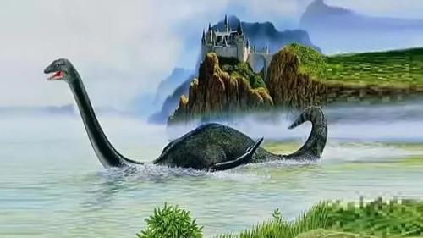
4. Simulation and Role Play
Characteristics:
a ‘reality of function’ (students must accept the role)
a simulated environment (we imagine environment)
structure (there must be some structure to the simulation and essential facts must be provided)
Activity “The Loch Ness Monster”
Stage 1. Students are told that the monster has been seen by a number of people who are going to describe it to the local police in Scotland.
Stage 2. Students work in groups of 5. One student in each group is a police inspector who questions the other students (witnesses) about what they have seen and then fills in the form and draws the picture of the monster.
Stage 3. The students in each group are given the role cards with the description of the situation and with the instructions on what they are supposed to say. The activity can start after each “witness” has had a chance to study the role card.

Slide 30
3. Teaching Writing
5 major types of classroom writing performance:
1. Writing down.
Dictations typically involve the following steps:
Teacher reads a short paragraph once or twice at normal speed.
Teacher reads the paragraph in short phrase units of three or four words each and each unit is followed by a pause.
During the pause, students write exactly what they hear.
Teacher then reads the whole paragraph once more at normal speed so students can check their writing.

Slide 31
2. Controlled writing
It typically appears in written grammar exercises.
Examples of exercises:
alter the given structure (e.g. to change all present tense verbs to past).
dicto-comp (dictation + composition) – a paragraph is read at normal speed; then the teacher puts key words from the paragraph in sequence on the blackboard and asks students to rewrite the paragraph, using the words on the board.

Slide 32
3. Self-writing:
note taking (students take notes for the purpose of later recall)
diary or journal writing
4. Display writing:
short answer exercises
essay examinations
research reports

Slide 33
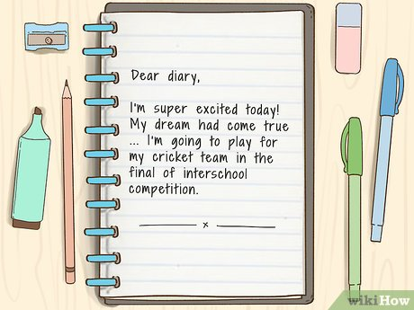
5. Real writing:
Academic (students exchange information with each other and with the teacher).
Personal
(diaries, letters, post cards, notes,
personal messages, Valentine cards
and other informal writing within the
context of an interactive classroom).

Slide 34
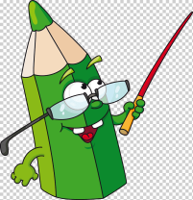
Examples of Writing Activities
True / False Statements. Students are given a list of statements and copy only the true ones.
Changing paragraphs. Students are given a paragraph and asked to make changes in it.
Write down the difference. Provide two pictures with a number of differences between them and ask the students to write down the difference.
Dialogue journal. On a regular basis (daily, weekly) students write in their journals as little or as much as they want, on whatever subject that interests them at the moment. They can ask questions, express opinions or make requests. Teacher reads the student’s entry and responds. In effect, the teacher and the student carry on a conversation via the journal.

Slide 35
Examples of Writing Activities
Collage. It’s a piece of artwork consisting of newspaper clippings, pictures from magazines, photographs, odd bits of colored paper. Students can make a collage about themselves, their families, their hobbies, etc.
Ink-shedding. Each student writes his ideas about the problem the teacher has provided and discuss each others’ ideas (Google Drive or Social Media can also be used for this activity).
Cartoon conversations. Give students copies of cartoons with the character’s dialogue omitted. Have students make up spoken dialogues, and then ask them write their ideas in the cartoons.
Story-starters. Students read the story in which the end has been deleted. They are then asked to finish the story.
Writing at the beginning of each class. The teacher writes a question on the board and gives the students five minutes to respond.

Slide 36
Creative writing helps children to:
Share information about themselves, their needs, and their problems.
Express ideas and thoughts.
Write about impressions.
Express thanks.
Formulate ideas and communicate them to others.
Write letters.

Slide 37
Tips to become a good writer:
Focus on a goal or main idea in writing.
Spend some time planning what to write.
Let your first ideas flow onto the paper.
Make up a plan of what you are going to write.
Reread your work and correct it if necessary.

