Slide 1
Презентація на тему «Число 10»
Навчальний зошит 1 клас
Виконала:
студентка 5 к. 3 гр.
Факультету початкового навчання
Волощук Марія

Slide 2
1)
8
2)
7
3)
6,
5,
4,
3,
2,
1
4)
6,
7
5)
4,
5

Slide 3
.
8
.
1
2
3
4
5
6
7
8
9
10

Slide 4
1
2
3
4
5
6
7
8
9
10

Slide 5
.
+1
-1
1
2
3
4
5
6
7
8
9
10
11
10 – це 9 і 1
10 – це 11 без 1
10 = 9 + 1
10 = 11 - 1

Slide 7
9
4
5
9
2
5
?
?
?
4
+
5
= 9
9
-
5
= 4
9
–
2
= 7

Slide 8
4
4
7
.
.
?
8
?
5
2
4
+
4
= 8
7
-
2
= 5
8
.
3
?
5
8
-
3
= 5

Slide 9
5 + = 9
+ 3 = 9
8 + = 9
+ 7 = 9
1 + = 9
1 + = 8
+ 5 = 8
6 + = 8
+ 4 = 8
+ 7 = 8
5 + = 7
+ 4 = 7
6 + = 7
3 + = 7
+ 2 = 3
3 + = 6
+ 2 = 6
5 + = 6
+ 3 = 5
2 + = 4
4
7
2
3
9
8
7
6
4
6
3
3
5
1
5
3
4
7
2
3
6
3
3
4
3
5
4
1
2
2
1
1
8
6
6
5
1
2
1
2
1
2
4
4
2
4
3
7
4
4
1
8
1
2
1
1
8
7

Slide 10
1. Математичний диктант
1)
7
2)
1 0
3)
6,
7,
8
4)
4,
5
5)
8,
1 0
6)
8

Slide 11
<
<
<
>
<
<
<
<
<
>
<
>
>
>
>
>
менше
більше
.
1
2
3
4
5
6
7
8
9
10

Slide 12
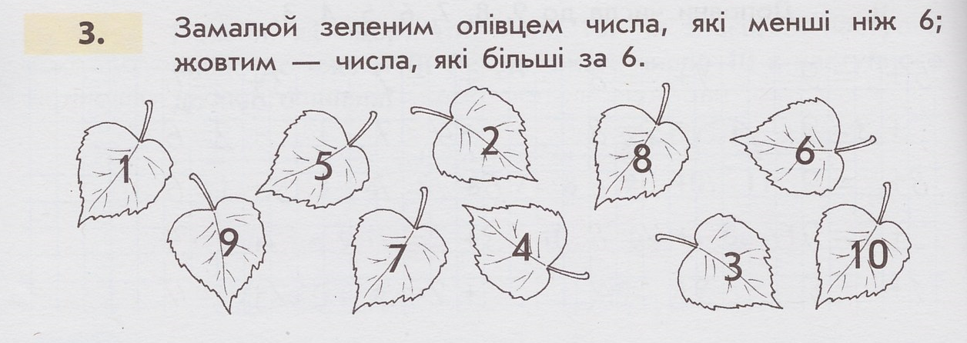
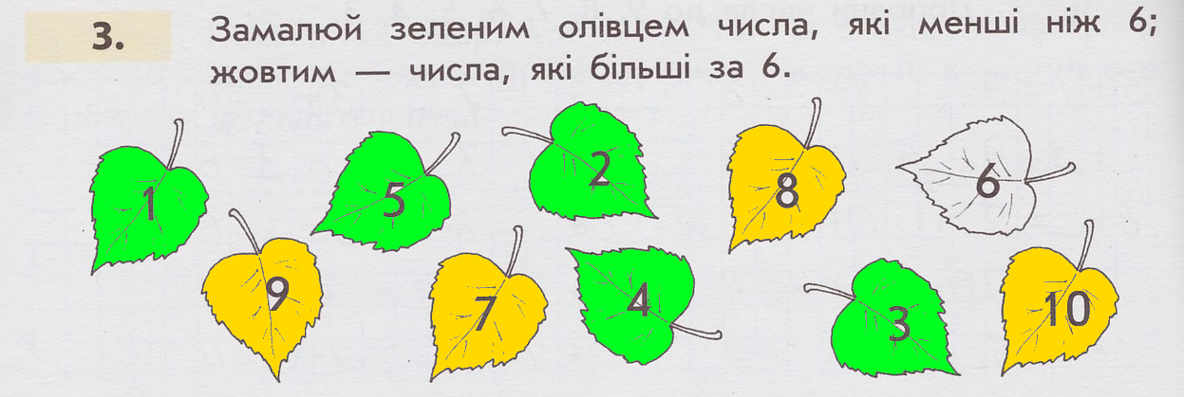

Slide 13
<
менше
більше
.
1
2
3
4
5
6
7
8
9
10

Slide 14
3
5
2
5
7
8
2
1
1
6
7
4
2
4
6
3
1
3
5
6
4
7 + 1 =
8
3 + 4 =
7
6 + 3 =
9
3 + 5 =
8
2 + 5 =
7
7 + 2 =
9
2 + 6 =
8
1 + 6 =
7
4 + 5 =
9
1 + 7 = 8
5 + 2 = 7
8 + 1 =
9
4 + 4 = 8
4 + 3 = 7
3 + 6 = 9
5 + 3 = 8
6 + 1 = 7
2 + 7 = 9
6 + 2 = 8
5 + 4 = 9
1 + 8 = 9

Slide 15
5 + = 9
+ 3 = 9
1 + = 9
+ 2 = 9
1 + = 7
9
8
7
6
8 + = 9
+ 6 = 9
4 + = 9
1 + = 8
+ 2 = 7
5 + = 8
+ 3 = 8
2 + = 8
+ 5 = 7
4 + = 6
4 + = 8
7 + = 8
+ 6 = 8
3 + = 7
+ 3 = 6
4
1
4
3
6
5
4
1
7
1
6
4
2
3
6
1
2
6
3
5
3
5
2
3
3
8
5
6
1
8
6
3
2
5
7
2
4
7
7
2
2
6
3
4
5
3
2
6
8
1
4
4
3
6
7
1
4
5
2
6

Slide 16
2
3
2
+
1
= 3
3
4
4
-
1
= 3
7
8
7
+
1
= 8
4
5
5
-
1
= 4
2
3
3
-
1
= 2
6
7
6
+
1
= 7

Slide 17
1 0
9
7
4
3
2

Slide 18
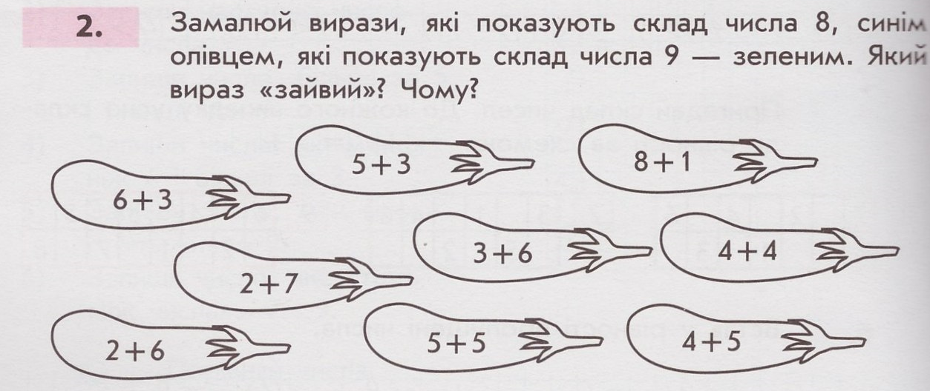
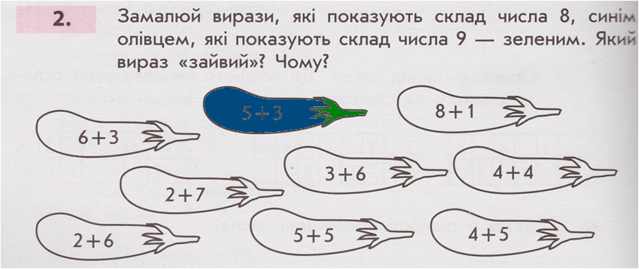
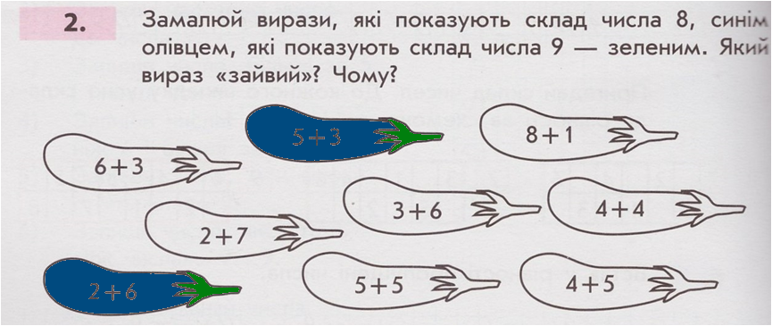
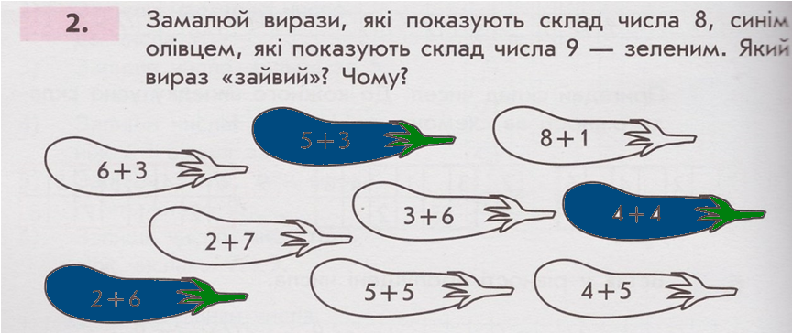
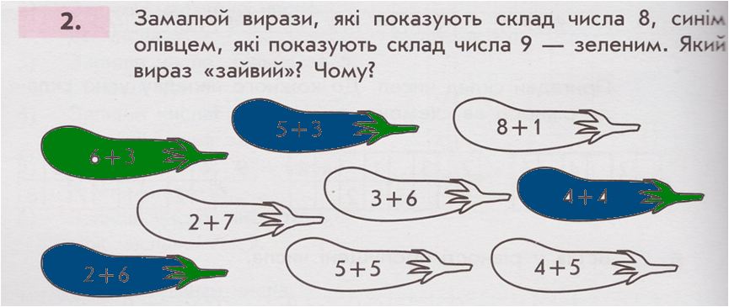
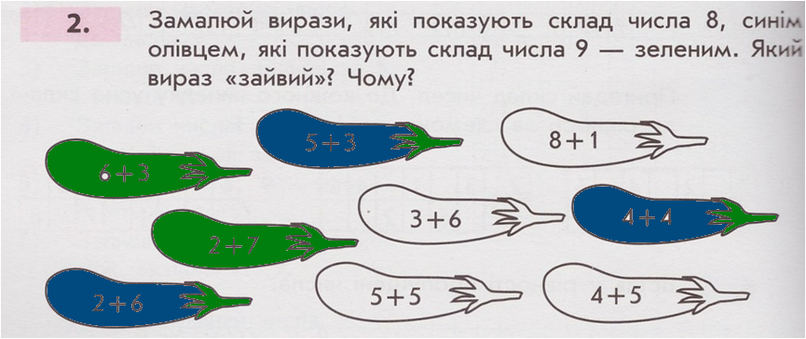
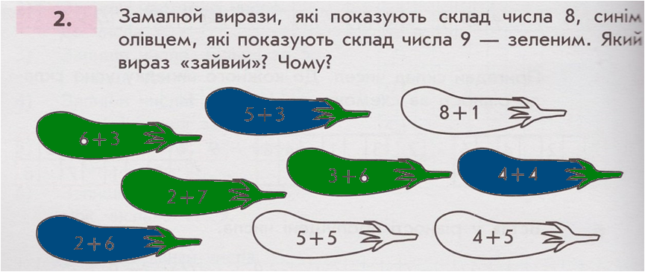
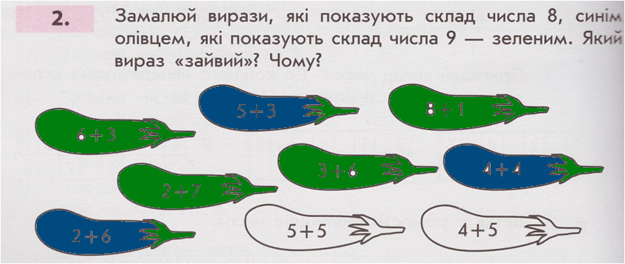
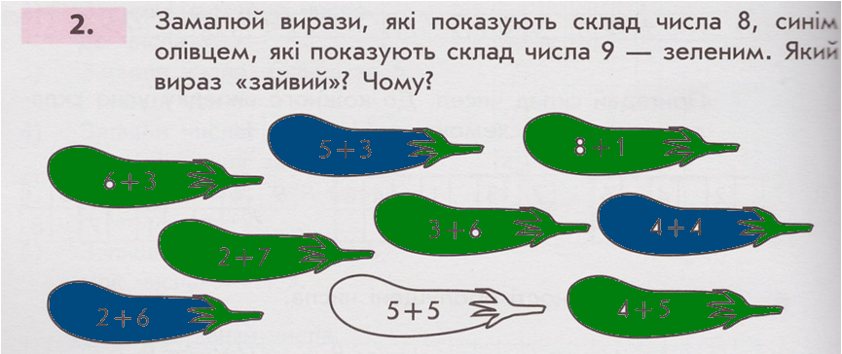

Slide 19
9
1
8
2
7
3
6
4
5
5
4
6
3
7
2
8
1
9

Slide 20
1
2
3
4
5
6
7
8
9
1 + 9 =
1 0
9 + 1 = 1 0
2 + 8 =
1 0
8 + 2 = 1 0
3 + 7 =
1 0
7 + 3 = 1 0
4 + 6 =
1 0
10
6 + 4 = 1 0
5 + 5 = 1 0

Slide 21
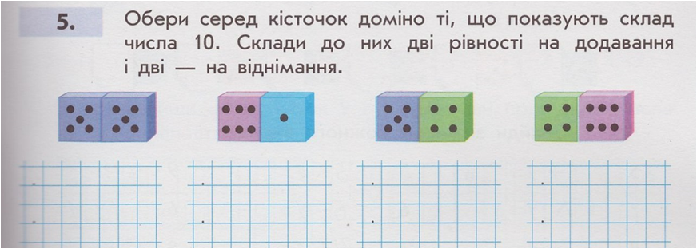
5
4
+
+
5
6
= 1 0
= 1 2
5
= 1 2
6
+
+
5
4
= 1 0
1 0
1 2
-
-
5
4
= 6
= 5
1 2
-
6
= 4
1 0
-
5
= 5

Slide 22
.
8, 9
1
2
3
4
5
6
7
8
9
10
.
2,3,4,5
1
2
3
4
5
6
7
8
9
10
.
3,4,5,6,7
1
2
3
4
5
6
7
8
9
10

Slide 23
6
4
7
5
3
2
5 + 1 = 6
3 + 1 = 4
6 + 1 = 7
4 + 1 = 5
2 + 1 = 3
1 + 1 = 2

Slide 24
5
6
5
+
1
= 6
5
6
6
-
1
= 5
6
7
7
-
1
= 6
4
5
4
+
1
= 5
8
9
8
+
1
= 9
8
9
9
-
1
= 8
4
5
5
-
1
= 4
6
7
6
+
1
= 7
7
8
8
-
1
= 7

Slide 25
5
5
6
10
9
4
1
9

Slide 26
6
6
5
7
5

Slide 27
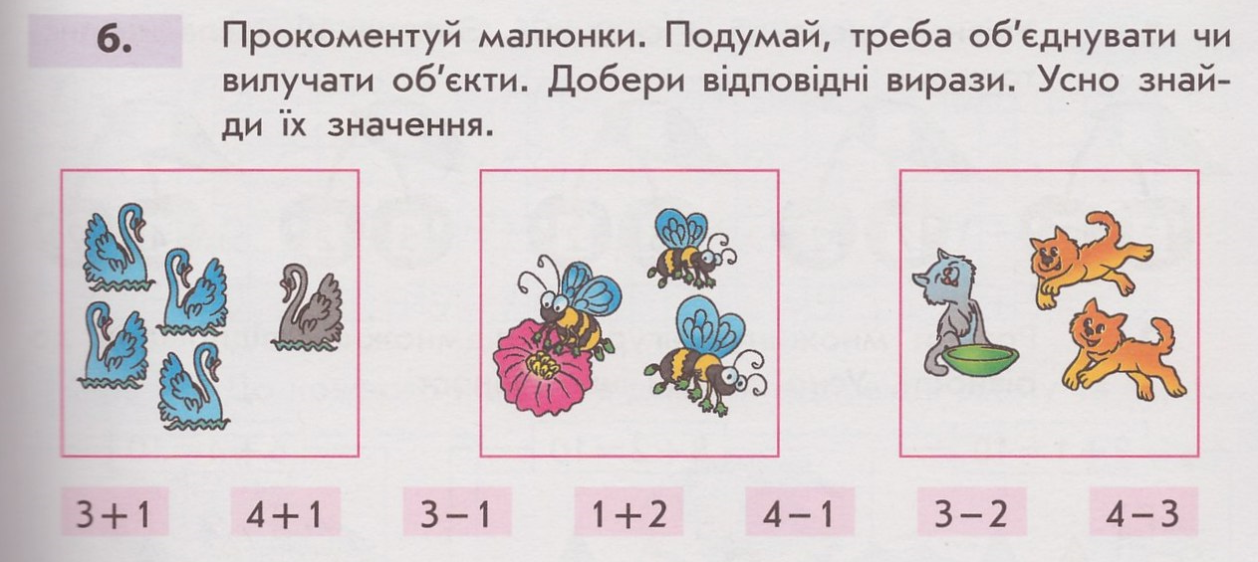
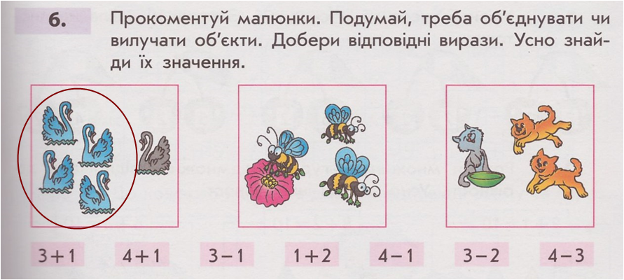
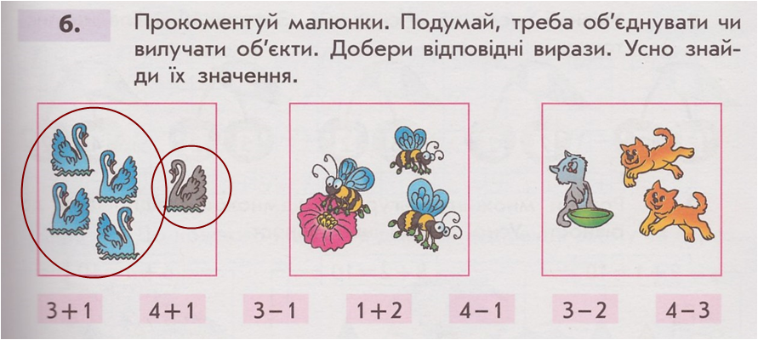
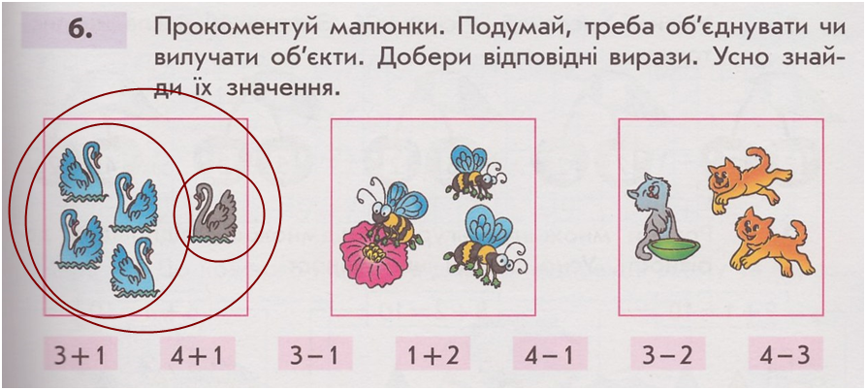
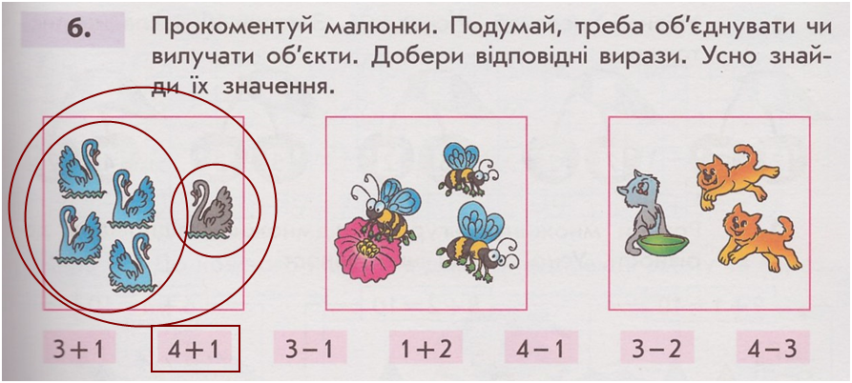
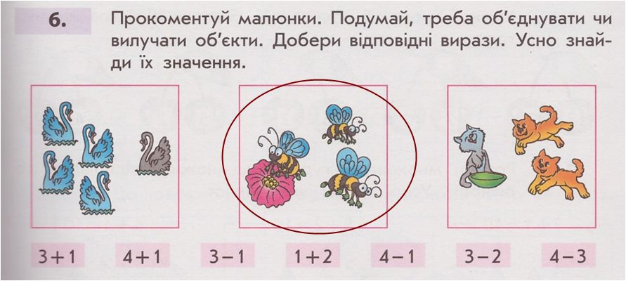
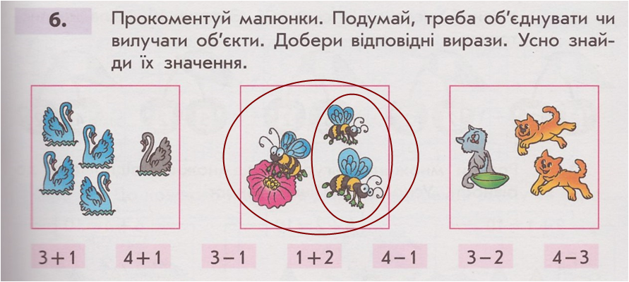
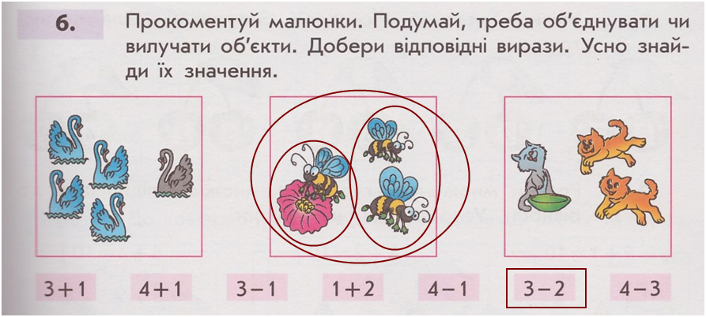
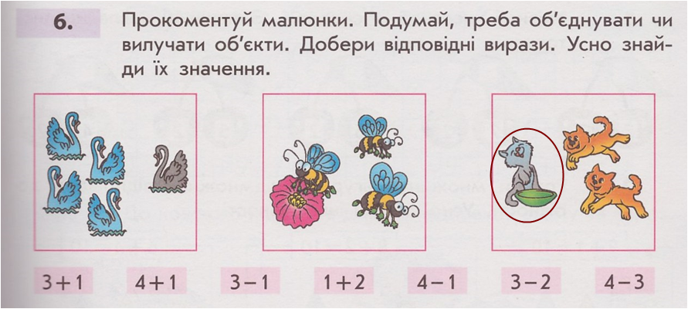
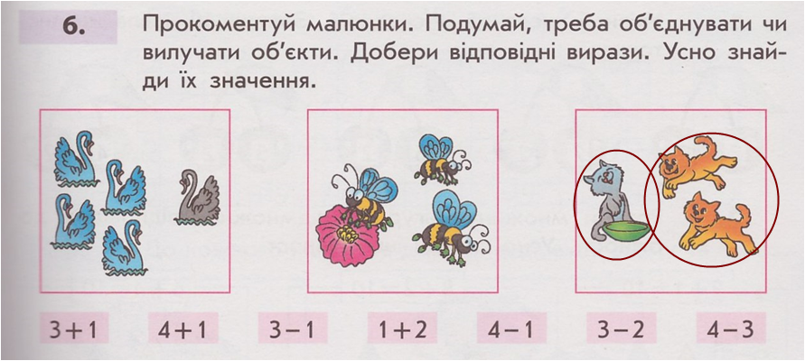
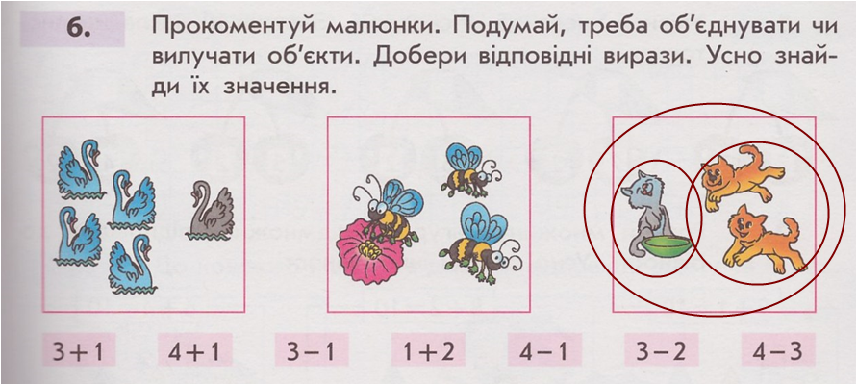
?
4
3
?
2
1
1
?
2

Slide 28
6
7
2
3
7
4
3
6
1
4
8
5
2
1
5
9
8
8 + . = 9
1
9 – 8 = .
1
8 + . = 10
2
10 – 8 = .
2
. + 3 = 9
6
9 – 3 = .
6
. + 3 = 10
7
10 – 3 = .
7
5 + . = 9
4
9 – 5 = .
4
9 + . = 10
1
10 – 9 = .
1
. + 2 = 9
7
9 – 2 = .
7
. + 6 = 10
4
10 – 6 = .
4
1 + . = 9
8
9 – 1 = .
8
5 + . = 10
5
10 – 5 = .
5
. + 7 = 9
2
9 – 7 = .
2
. + 7 = 10
3
10 – 7 = .
3
4 + . = 9
5
9 – 4 = .
5
. + 4 = 10
6
10 – 4 = .
6
. + 6 = 9
3
9 – 6 = .
3
1 + . = 10
9
10 – 1 = .
9
2 + . = 10
8
10 – 2 = .
8

Slide 29
5
9
8
7
6
3 + 2 = 5
7 + 2 = 9
6 + 2 = 8
5 + 2 = 7
4 + 2 = 6

Slide 30
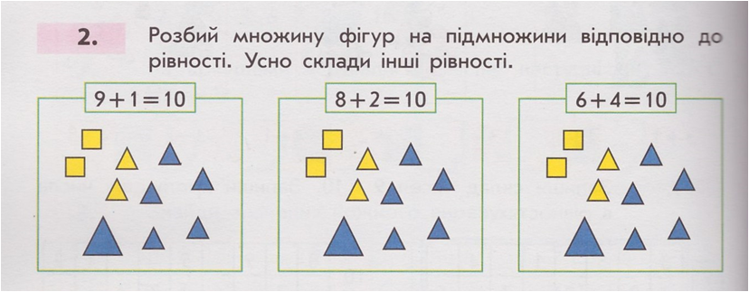
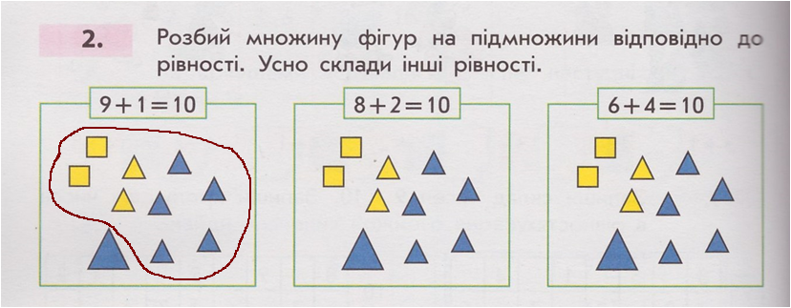
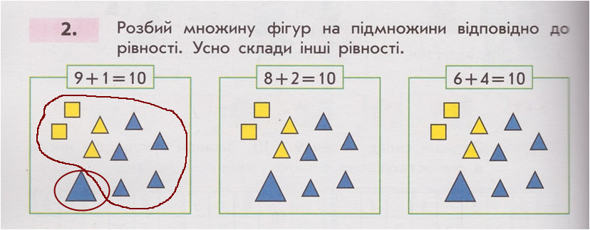
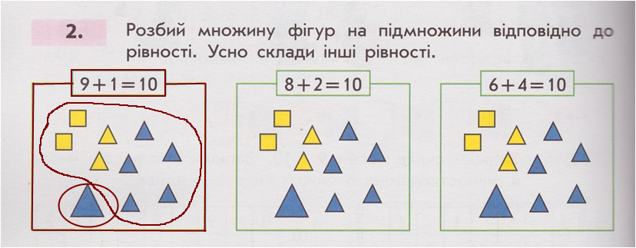
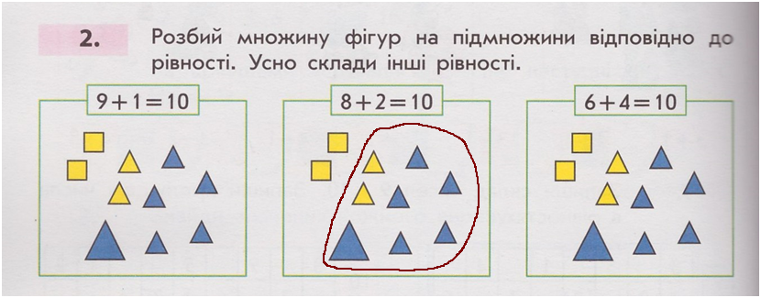
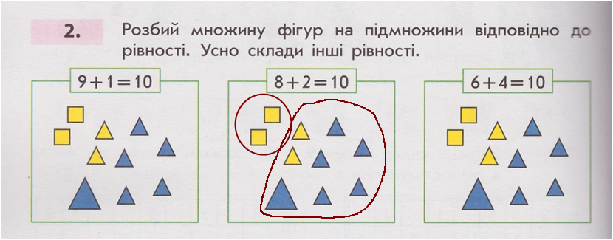
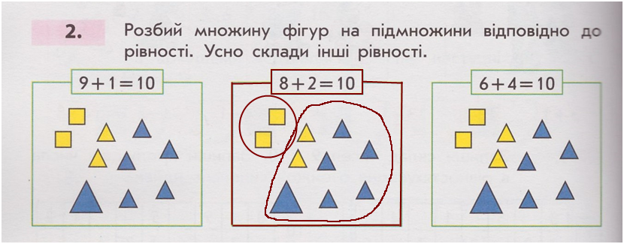
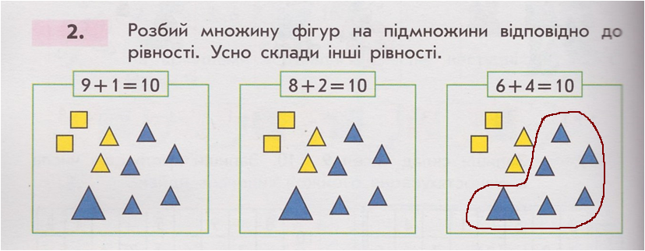
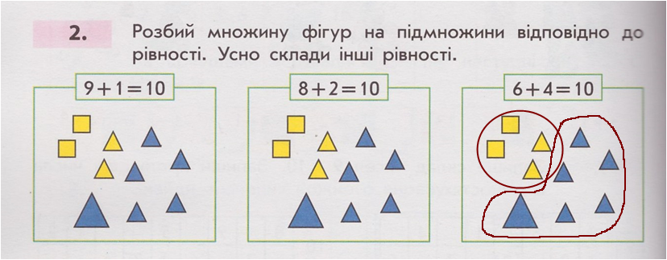
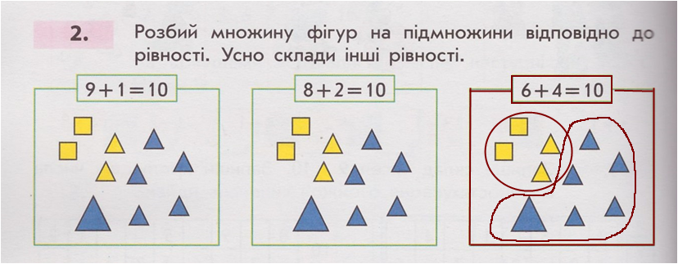
9
2
8
4
6
1
За розміром
За формою
За кольором

Slide 31
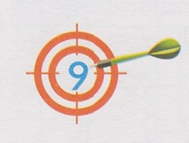
1 + 5 =
1 + 8 =
6
9
8 + 1 = 9
2 + 7 =
1
2
3
4
5
9
5 + 1 = 6
2 + 4 =
6
4 + 2 = 6
3 + 3 = 6
7 + 2 = 9
3 + 6 =
9
1
2
3
4
5
6
7
8
6 + 3 = 9
4 + 5 =
9
5 + 4 = 9

Slide 32
3
7
7
3
8
7
5
4
4
6
6
8
2
1
2
5
10
9
7
3
2
7
8
2
5
4
6
4
3
6
2
8
7
2
3
7
6
3
7
3
4
5
4
6
1
8
1
9
5
5

Slide 33
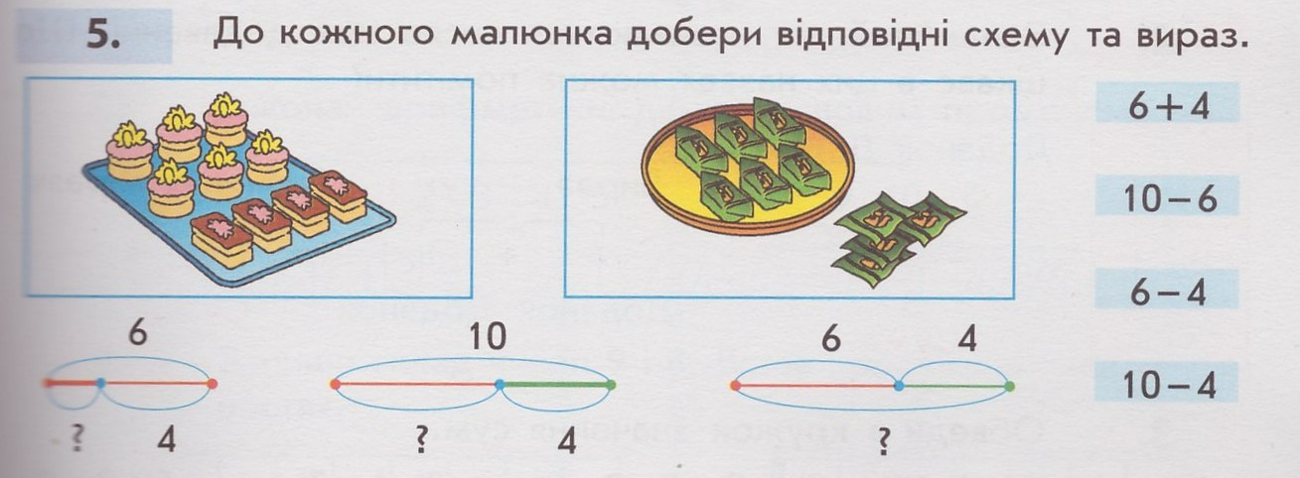
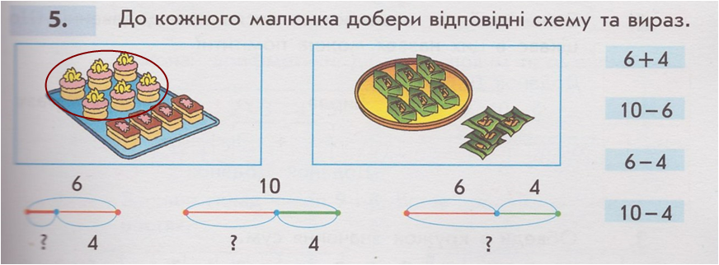
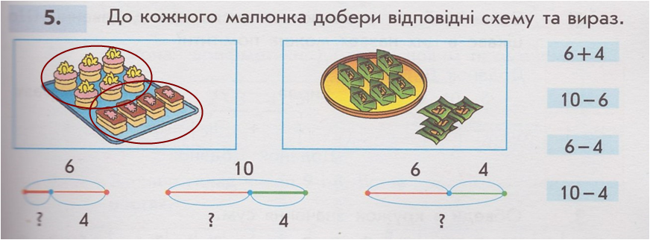
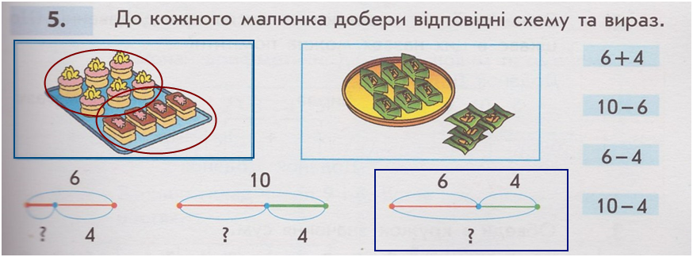
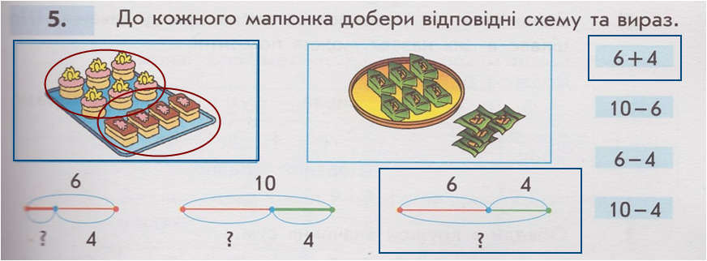
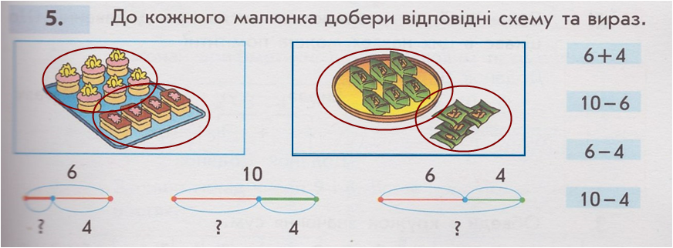
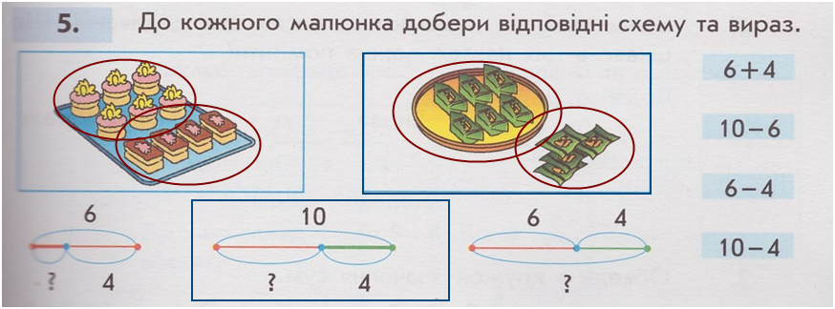
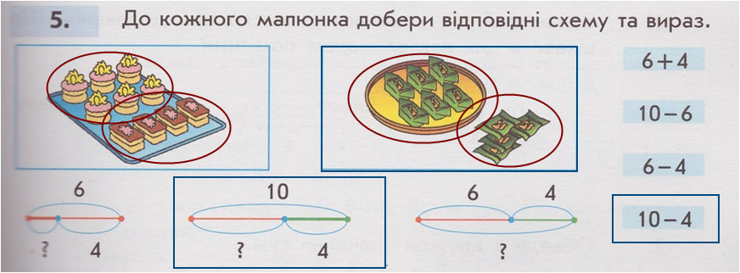
6
4
?
?
4
10
6
10

Slide 34
>
<
>
<
>
<
>
<
<
>
<
>
менше
більше
.
1
2
3
4
5
6
7
8
9
10

Slide 35
5 + 1 = .
6
7 – 1 = .
6
8 + 1 = .
9
4 + 1 = .
5
9 – 1 = .
8
1 + 1 = .
2
6 – 1 = .
5
8 – 1 = .
7
2 + 1 = .
3
1 0 – 1 = .
9
3 + 1 = .
4
9 + 1 = .
1 0
.
+1
+1
+1
+1
+1
-1
-1
-1
-1
+1
-1
+1
1
2
3
4
5
6
7
8
9
10

